Slide 1


Notes:
Thank you for taking the time to review our new general reference resource for students in grades 2-12 today.

Slide 2


Not all search bars are created equal
Notes:
It’s true that not all search bars are created equal. Quality returns matter. What good is getting hundreds of pages of returns if you have to spend hours sorting through them to find relevant content? And then more time trying to verify whether or not the content you found is credible and accurate?

Slide 3

Notes:
The Scholastic GO! search engines sits upon hundreds of thousands of credible, accurate, reliable content assets written by experts and verified by professional editors. These same editors then write the content at a variety of levels to ensure entry points into the learning for all skill and reading abilities. In the age of information and fake news – why is it more important than ever to provide researchers with a trusted place to find information?

Slide 4


75%
of students have no idea how to locate the articles and resources they need for their research.
Notes:
Because according to NJ Association of School Libraries, 75% of students have no idea how to locate the articles and resources they need for their research.

Slide 5

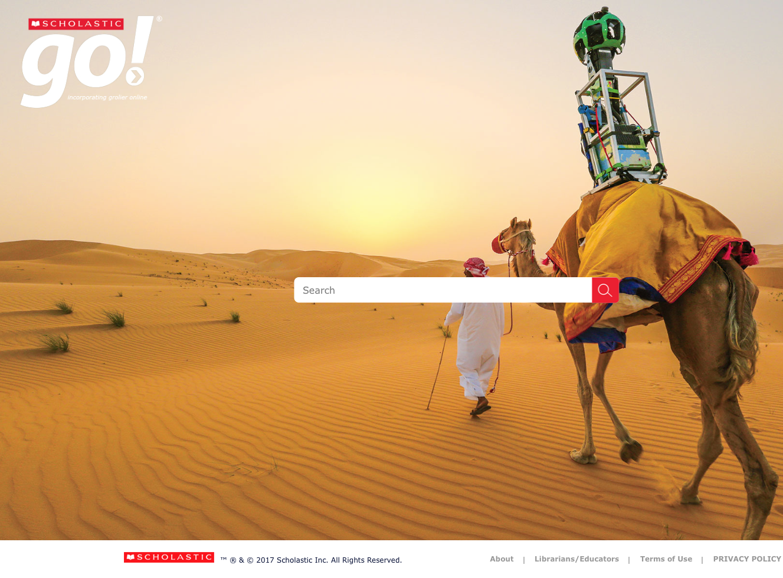
60%
of students don’t verify the accuracy or reliability of the information they find.
Notes:
And 60% of students don’t verify the accuracy of reliability of the information they find.

Slide 6

58%
of teachers report spending 2-5 hours per week searching for digital content.
Notes:
Additionally, as schools get further along in their digital implementation plans, more and more teachers are spending time searching for content for digital lesson plans and homework.

Slide 7
Notes:
Scholastic GO! Has been providing reliable articles and multimedia assets on core curriculum content to teachers and students for more than 10 years. But this year, it has been reimagined and re-engineered to have an increased focus on search and superior functionality around search returns. These upgrades have been designed to minimize the amount of time both teachers and students spend searching, allowing more time for teaching and learning.

Slide 8
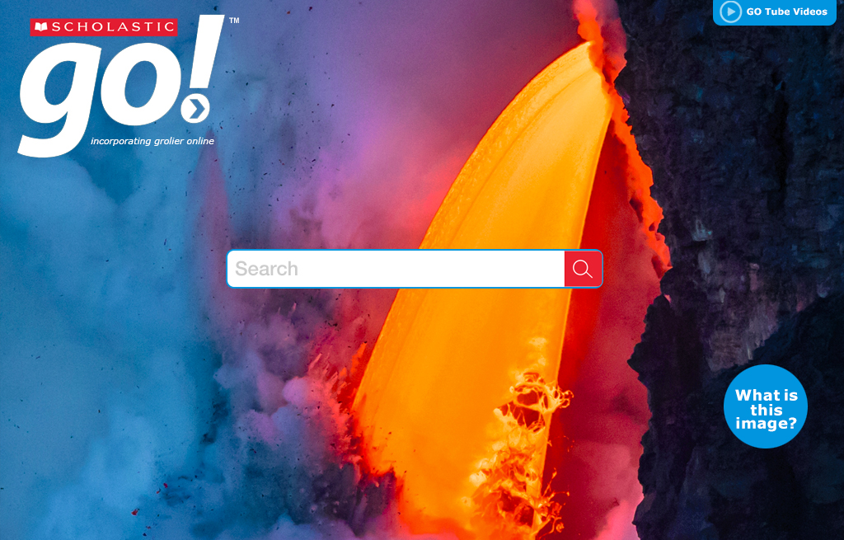
Notes:
Every two weeks the home screen will offer a new and exciting image that students can explore by clicking on the “What is this image” button.

Slide 9
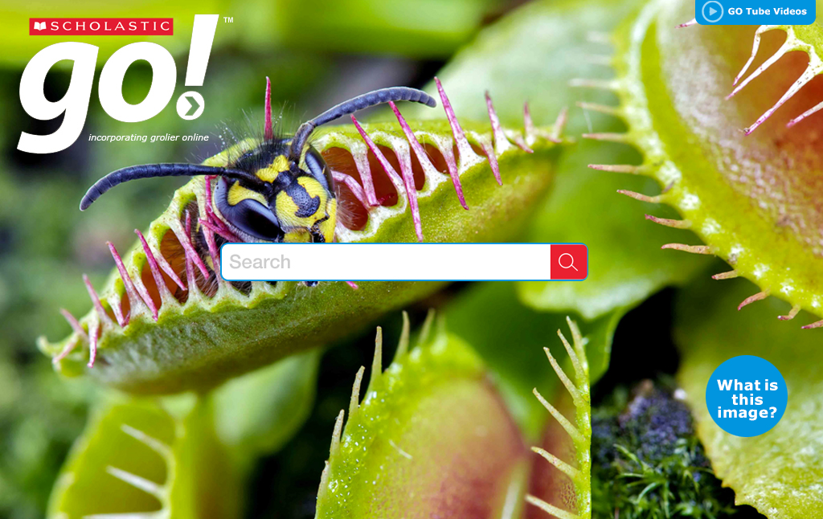
Notes:
Our GO Tube video library can be accessed directly from the homepage or from the top nav bar once in the product at anytime.

Slide 10
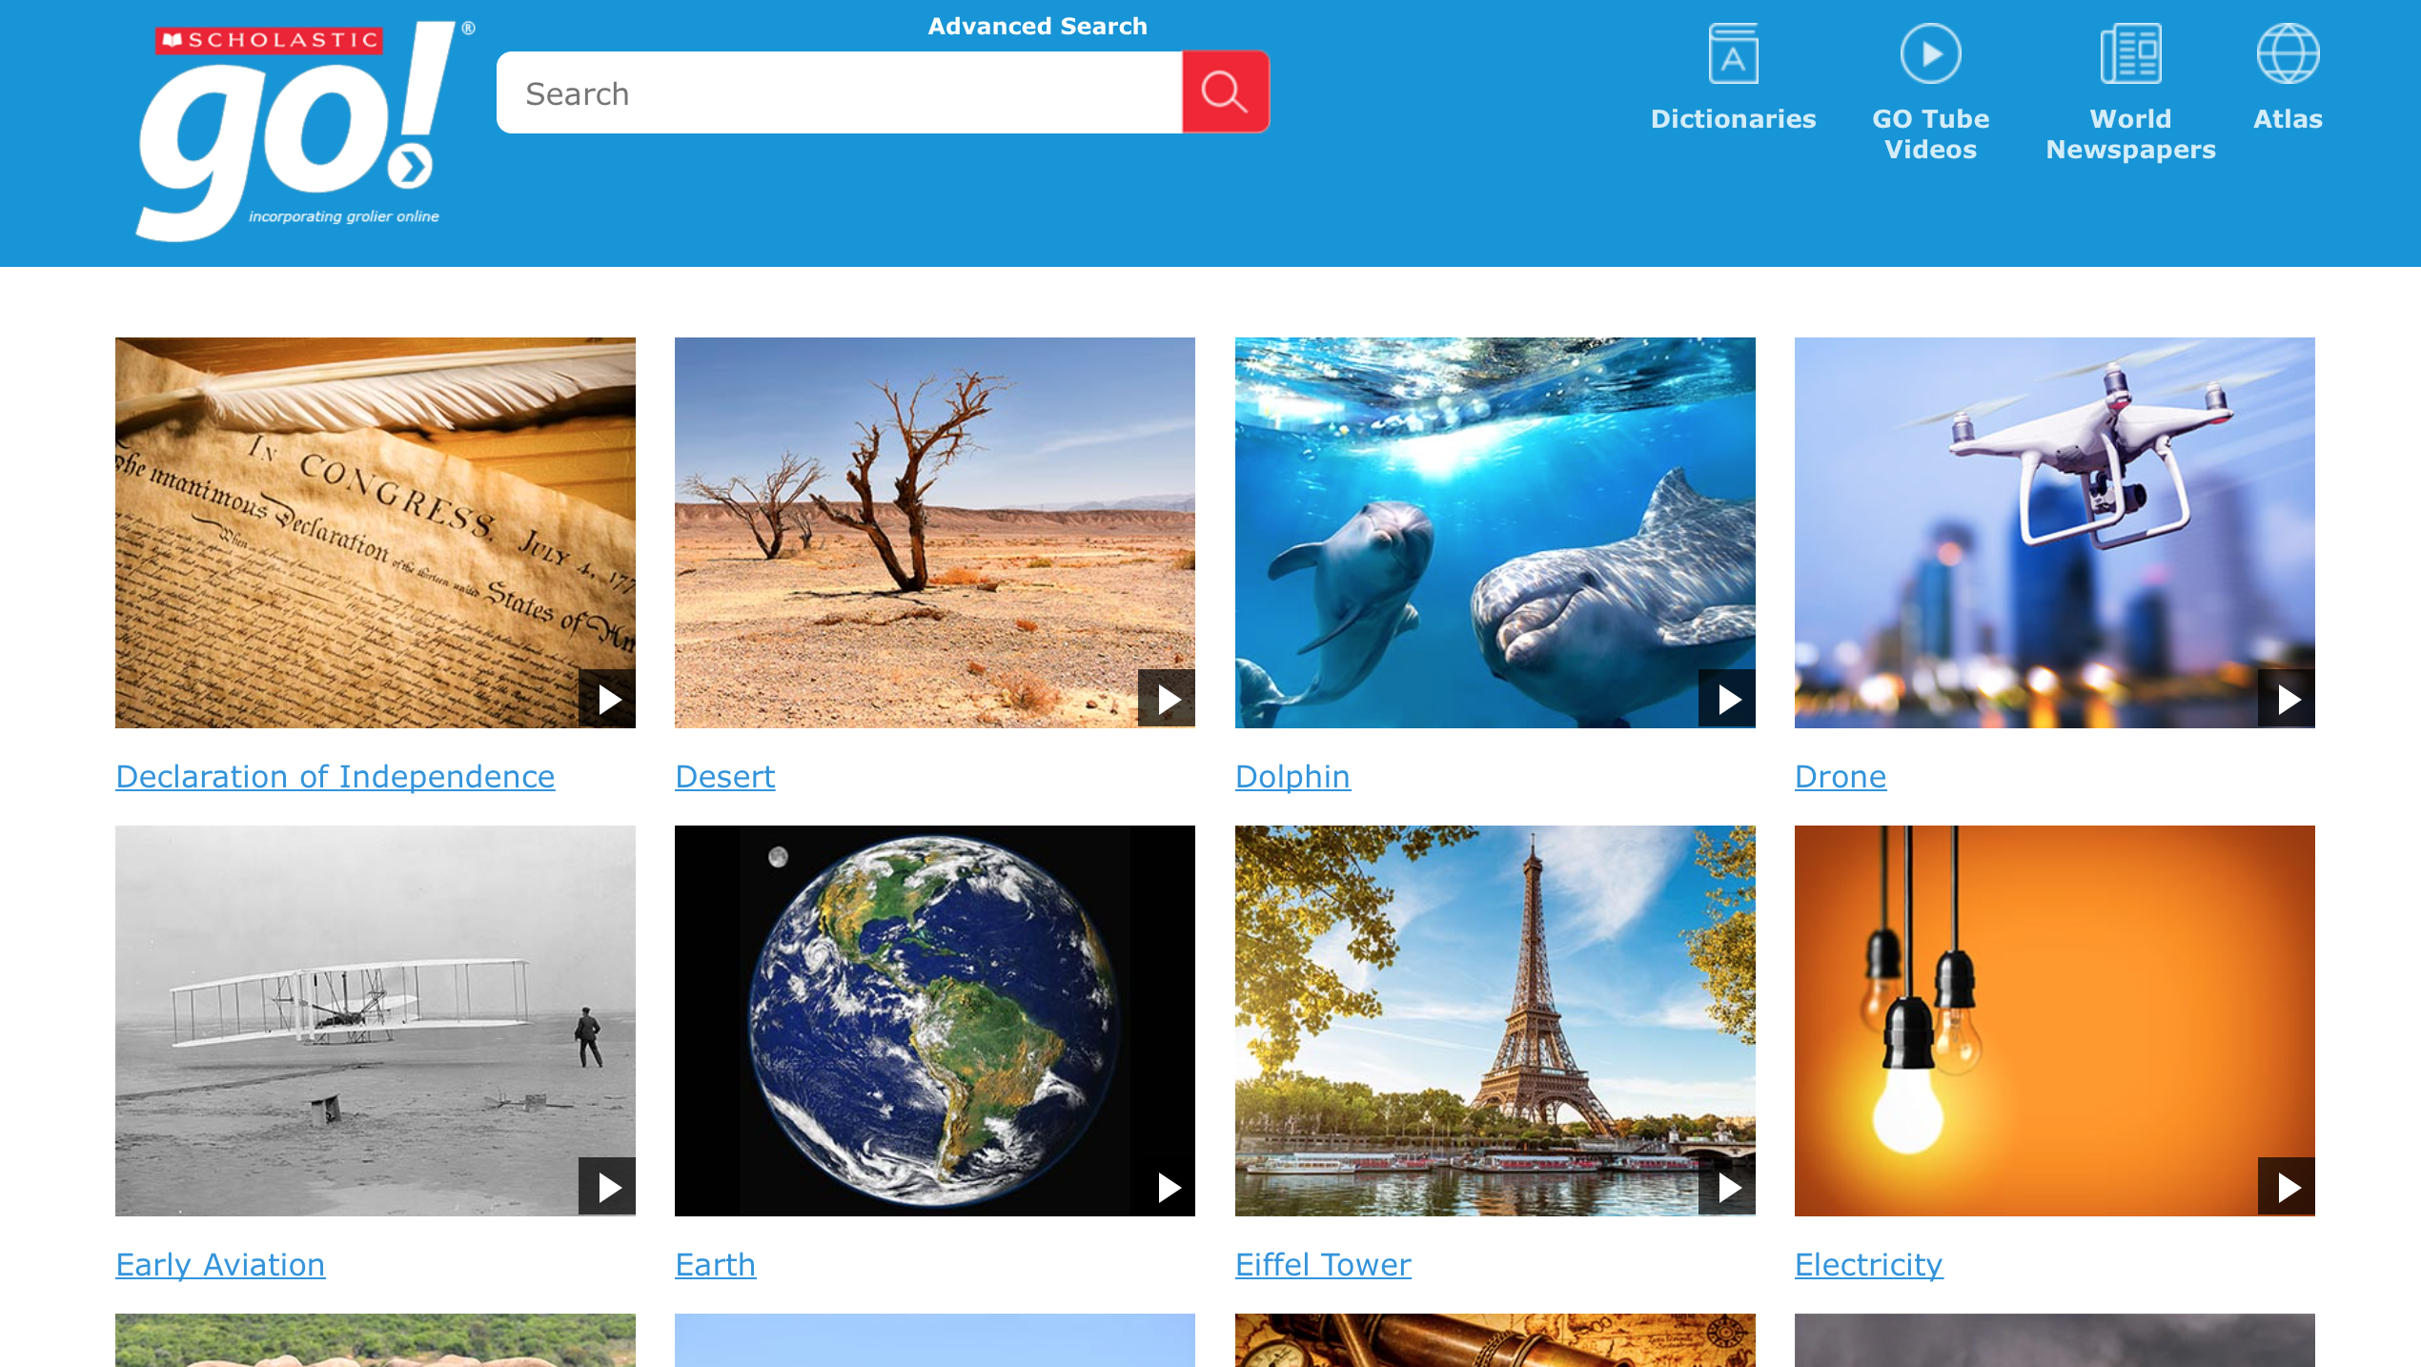
Notes:
Search and view hundreds of short videos to build background knowledge, engage visual learners or introduce a new topic

Slide 11
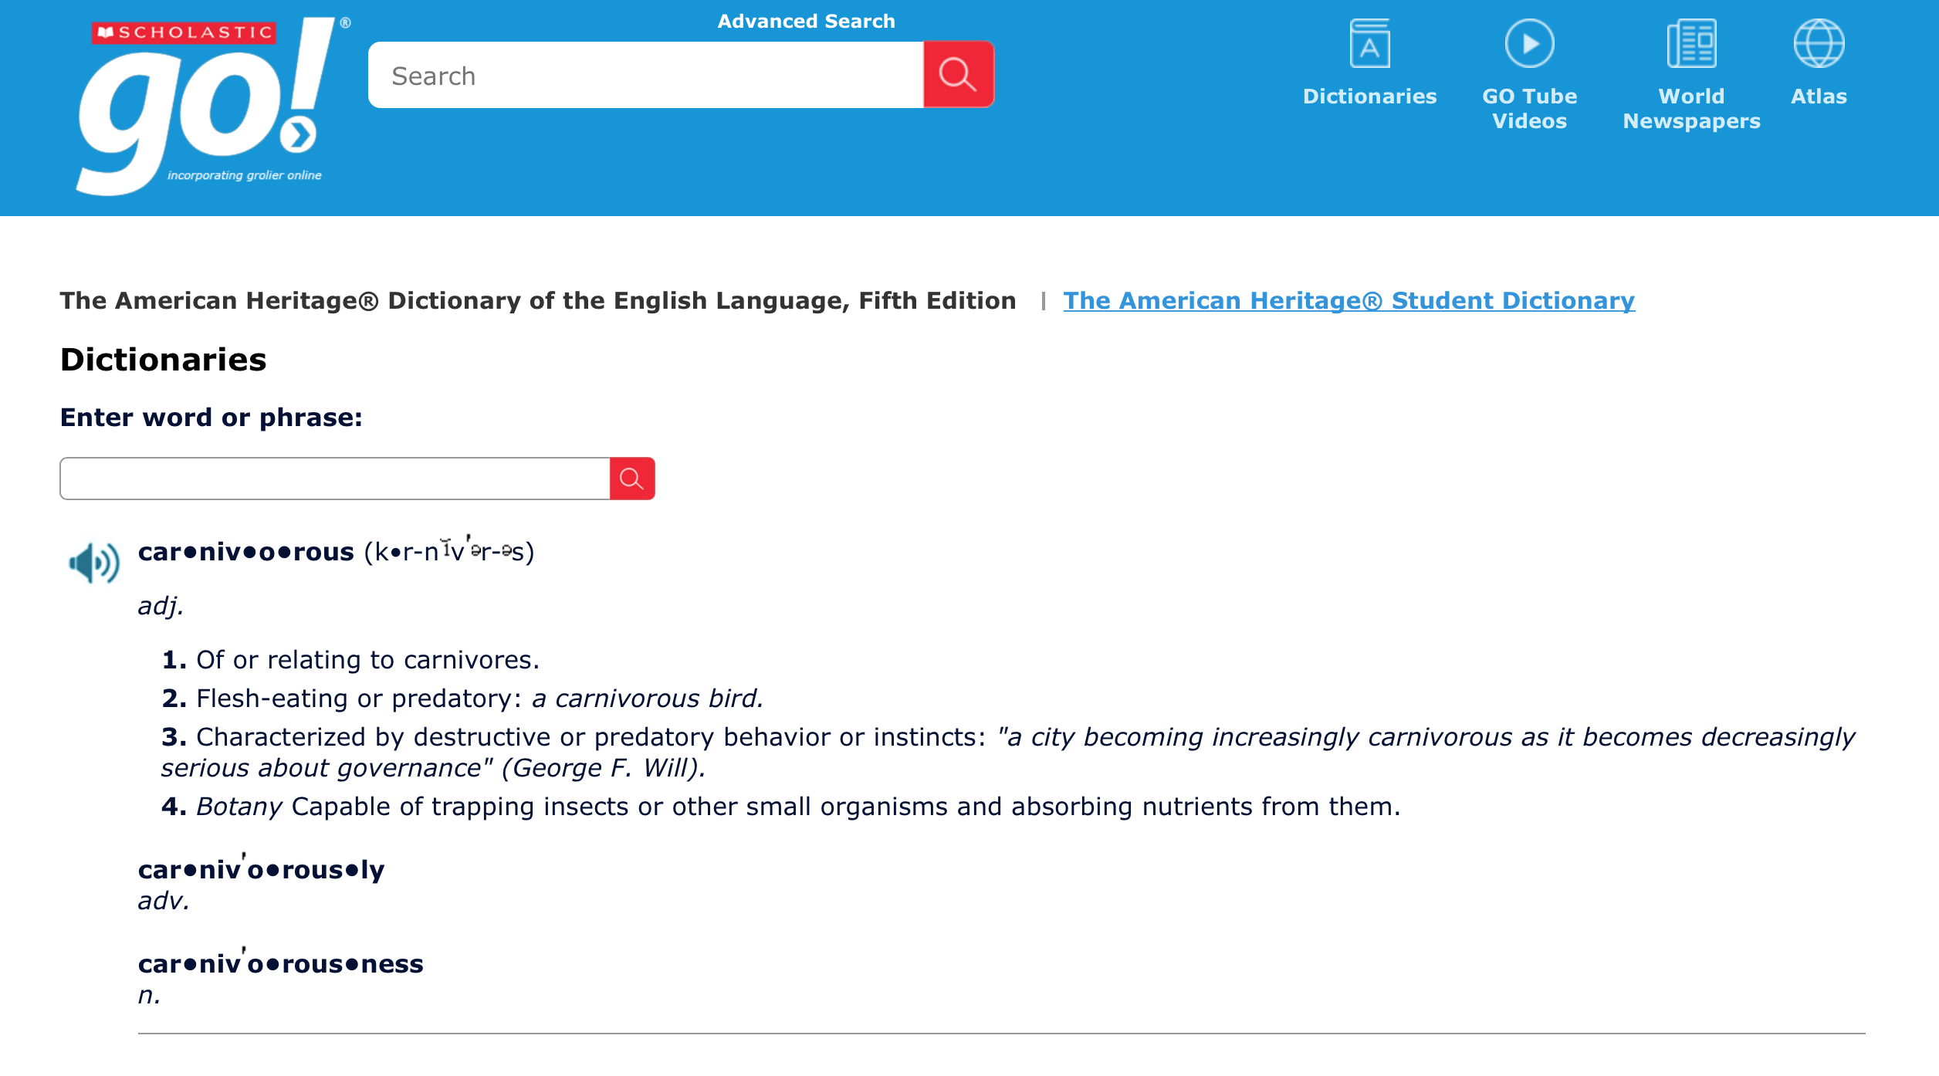
Notes:
The Dictionary is designed to easily build in-context vocabulary and can be used in multiple ways. A user can click on the dictionary icon and input any word they’d like defined or when reading an article or text asset, they can simply highlight the word in context, click dictionary, and have it immediately defined and pronounced for them.

Slide 12
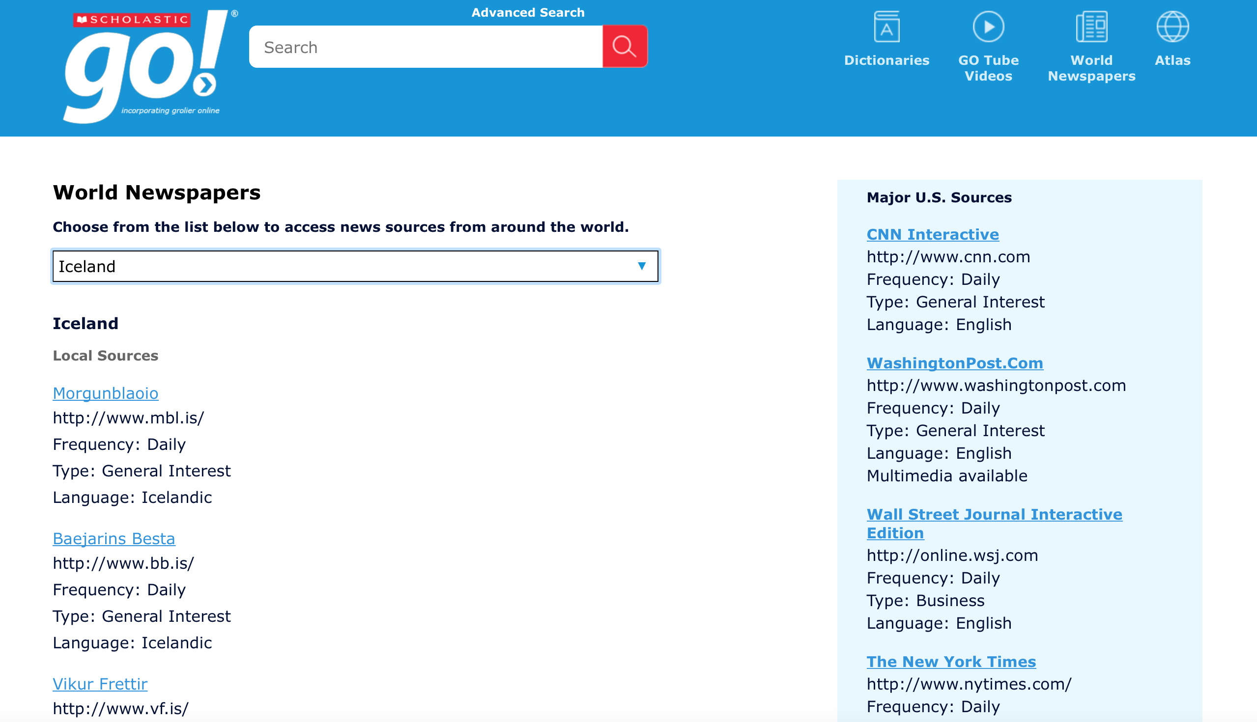
Notes:
GO also provides a portal to more than 1100 world newspapers in 73 languages. To access, simply click on the World Newspaper icon in the top navigation, click the drop down box and select your desired country from the alphabetical listing.

Slide 13
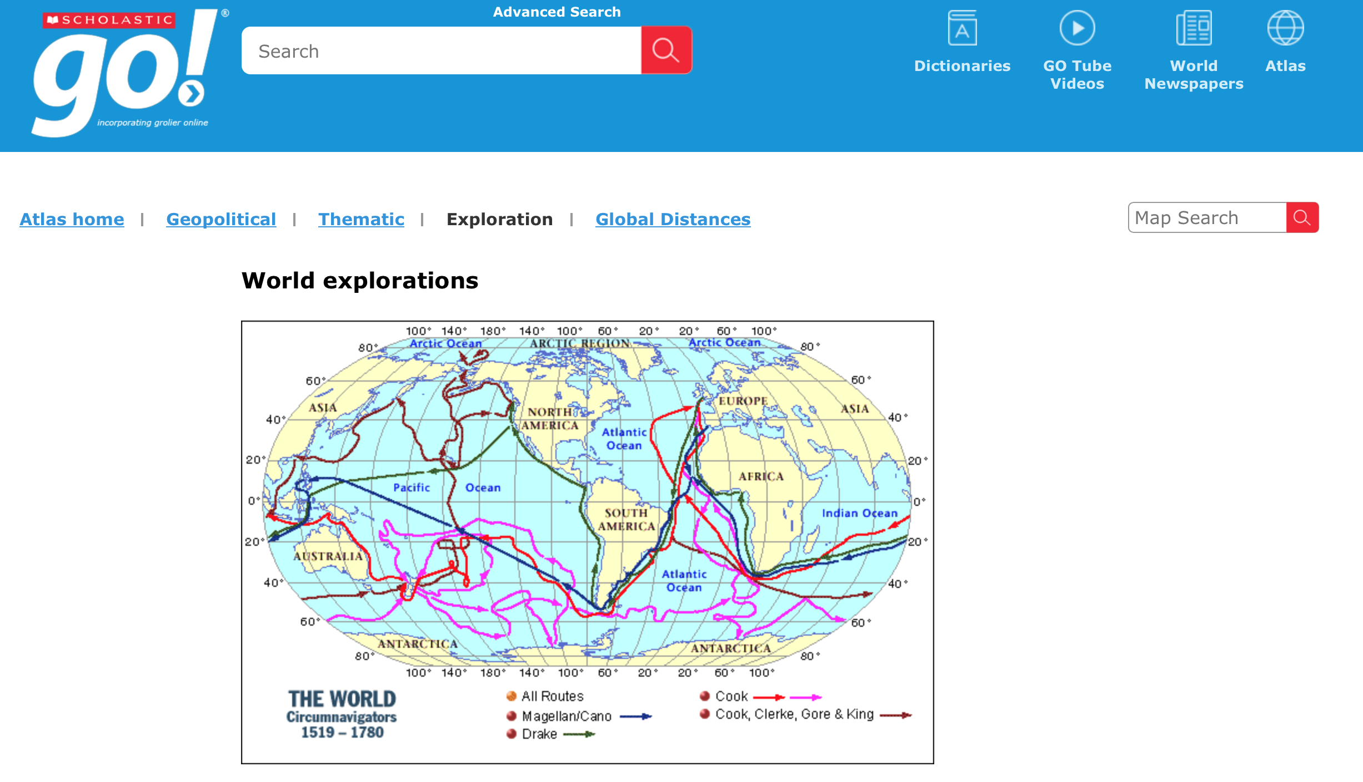
Notes:
The atlas is the last of the primary top navigation features and offers geopolitical, thematic, exploration and distance maps. Users can drill down further into each map by clicking on bolded text within the map. Related articles will appear below the map for further learning.

Slide 14
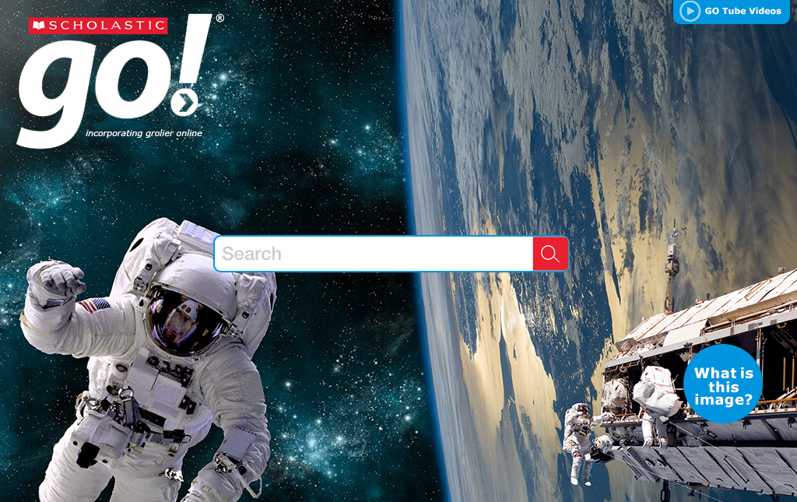
polar bears
Notes:
We’d like to show you a typical user search, return and learning opportunity experience now and have chosen polar bears to explore.

Slide 15
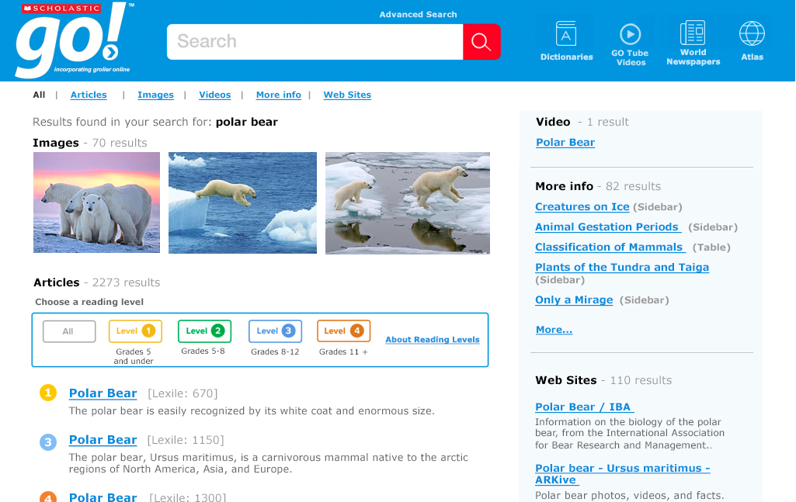
Notes:
You’ll see here, the search return for polar bears includes every type of media and text we have on polar bears in one clean and easy-to-navigate return. Images, videos, articles, additional text types and related websites are all returned at once for easy and efficient discovery. Users then have the option to explore directly from this page, filter by media type (above the images is this filter) and further filter the articles by reading level.

Slide 16
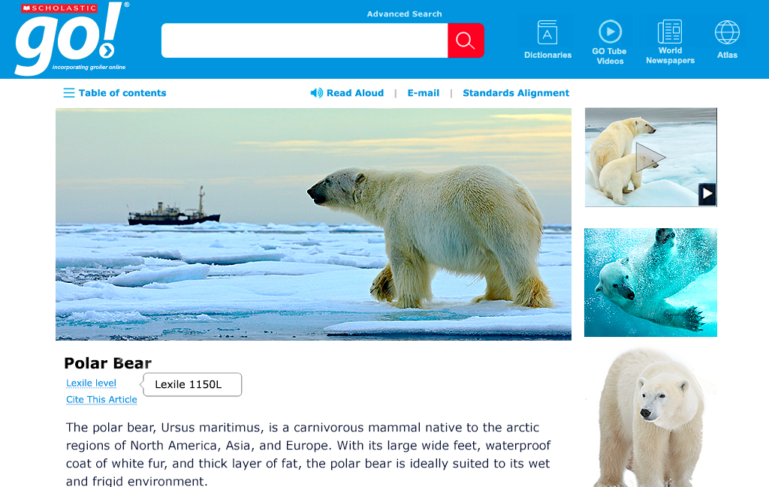
Notes:
This user has selected the 1150 Lexile article. You can see here some of the additional assets will travel with the user, including video and images to keep from having to return to the search return page to explore additional features.

Slide 17
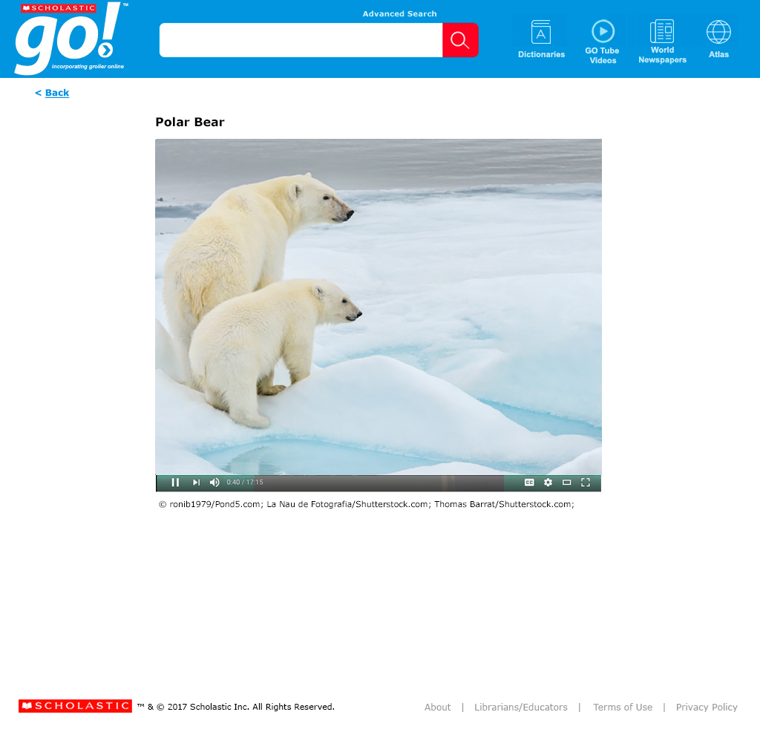
Notes:
Short videos add context and additional perspective and introduce academic vocabulary that will be encountered in the articles.

Slide 18
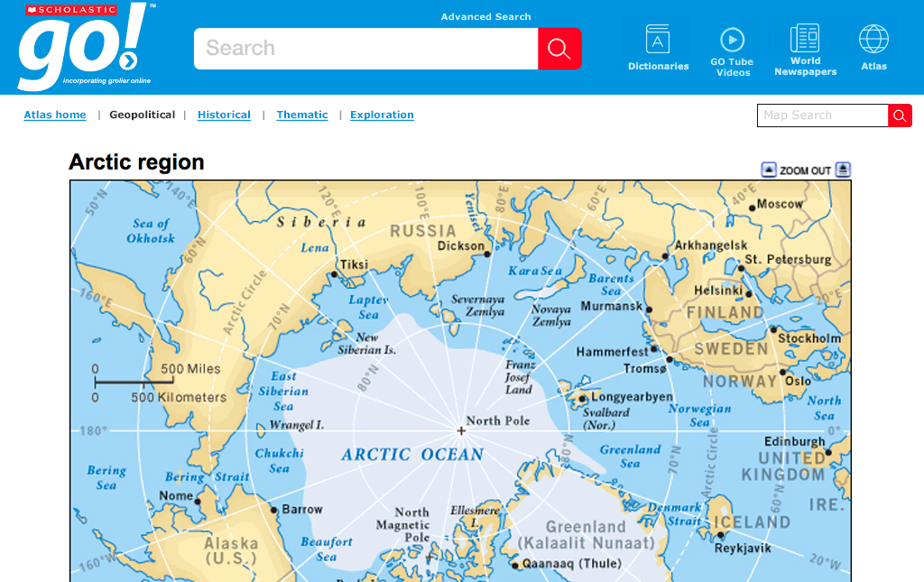
Notes:
Related maps also provide additional understanding, context, and a wider view of the subject.

Slide 19
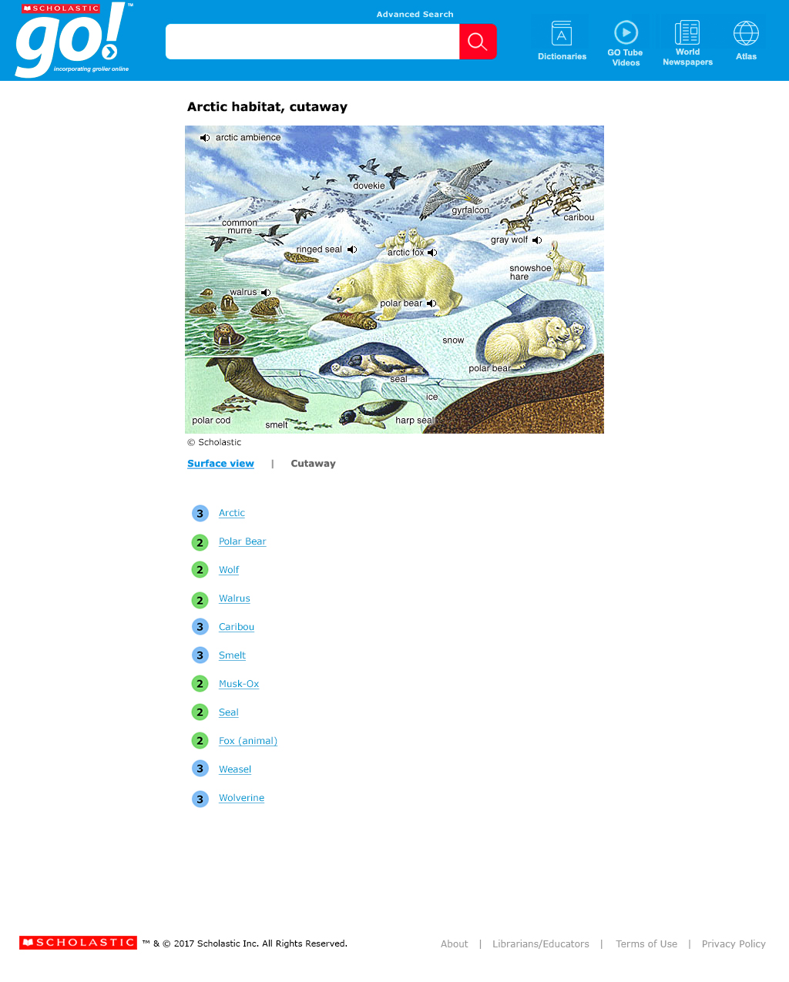
Notes:
Additional text types include fact boxes, charts, sidebar articles, cutways like the one you see here and more.

Slide 20
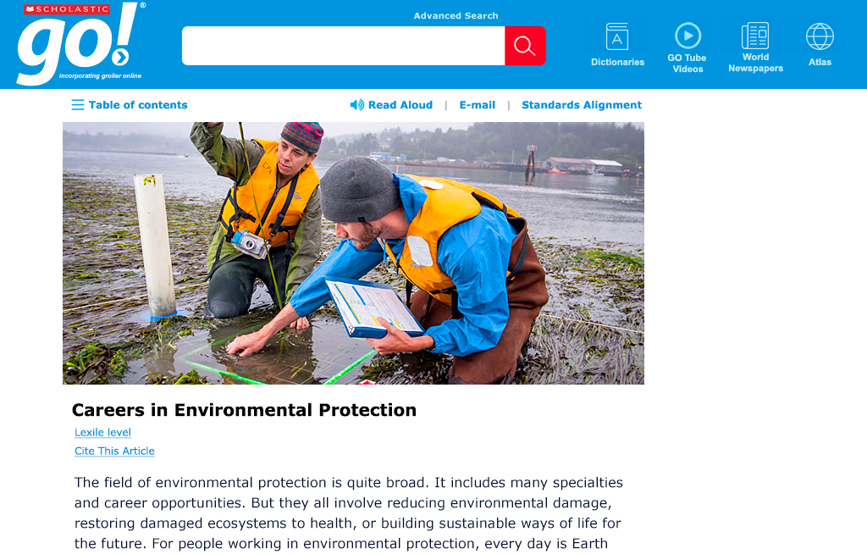
Notes:
Hundreds of career articles give real world context to research and include an occupation overview snapshot featuring estimated income, projected job growth, educational requirements and more.

Slide 21
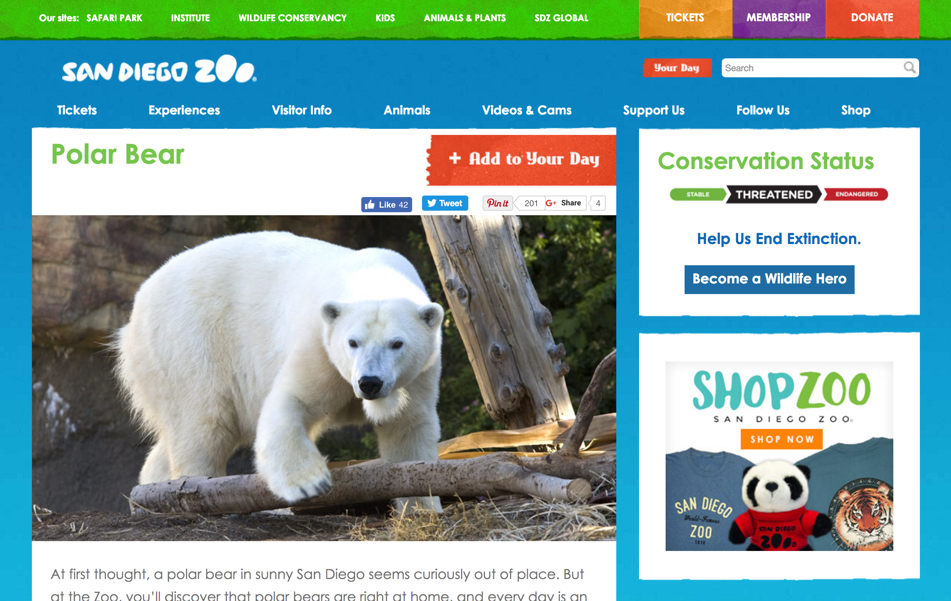
Notes:
GO includes more than 80,000 curated websites for additional learning. These websites have been editorially vetted and contain only age- and reading-level appropriate content and greatly support teachers as much as students looking for digital content.

Slide 22
China
Notes:
Now let’s search China, and take a look at some of the specific article features and supports.

Slide 23
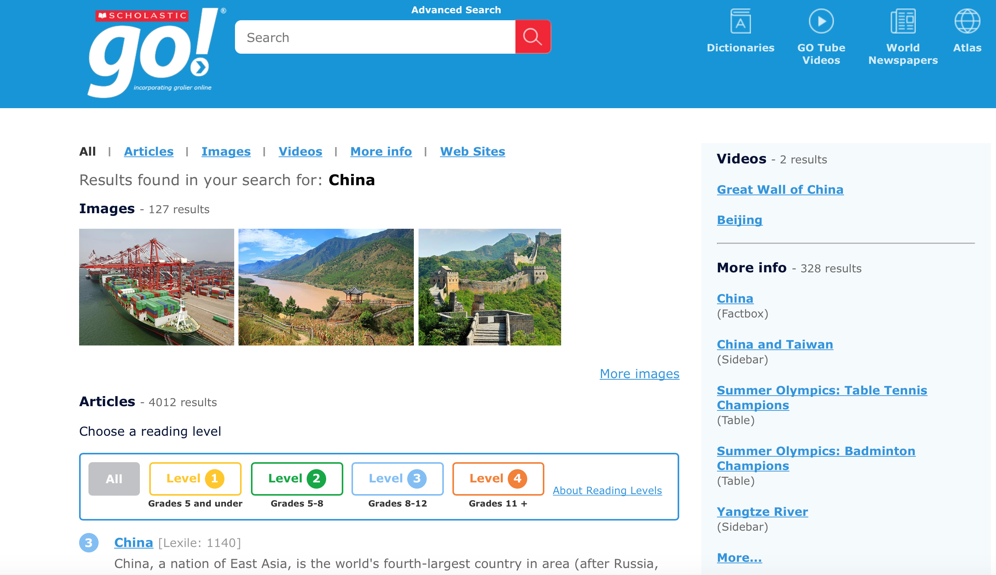
Notes:
You’ll notice the same return presentation as when we searched Polar Bears. The site was designed with repeat usability in mind and this predictable layout enables students to quickly find what they’re searching for and easily navigate the content.

Slide 24
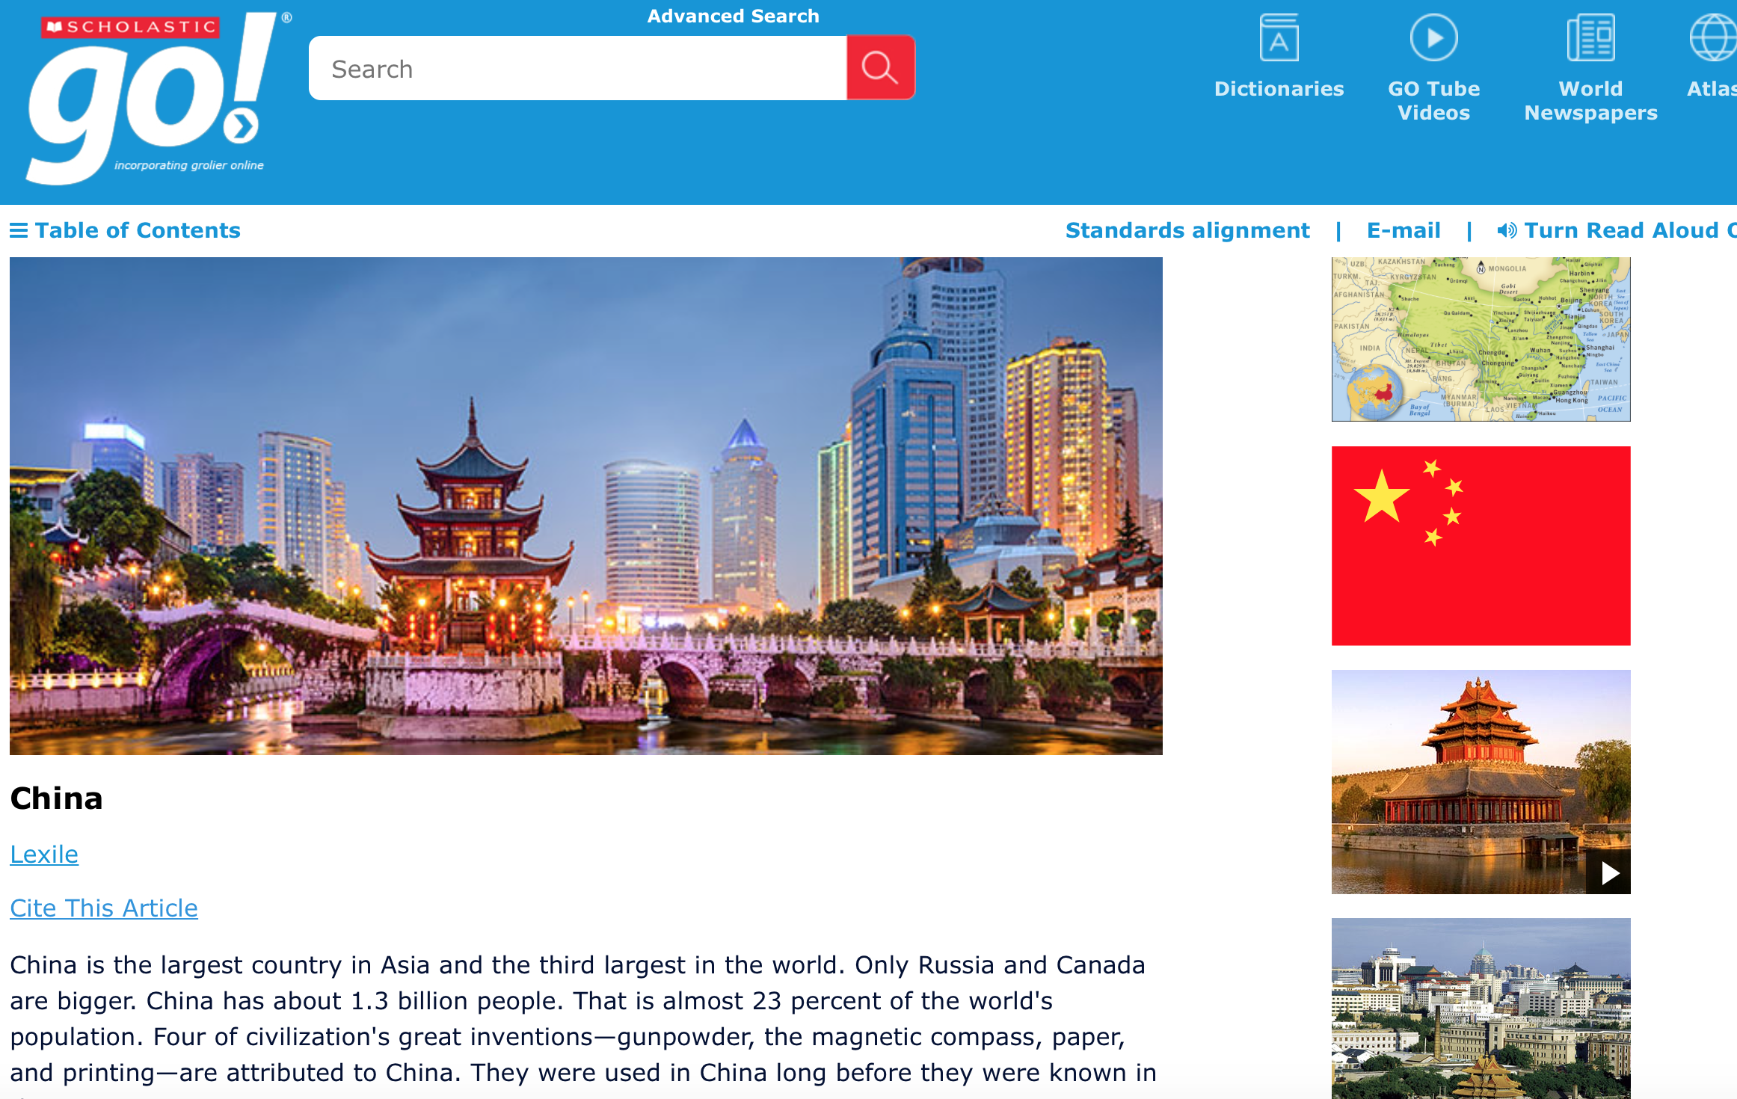
Notes:
Once in the article students can confirm the Lexile level if needed or quickly jump down to the citation if necessary.

Slide 25
Notes:
A Table of Contents is available for all articles that have multiple sections for quick and easy retrieval of desired information.

Slide 26
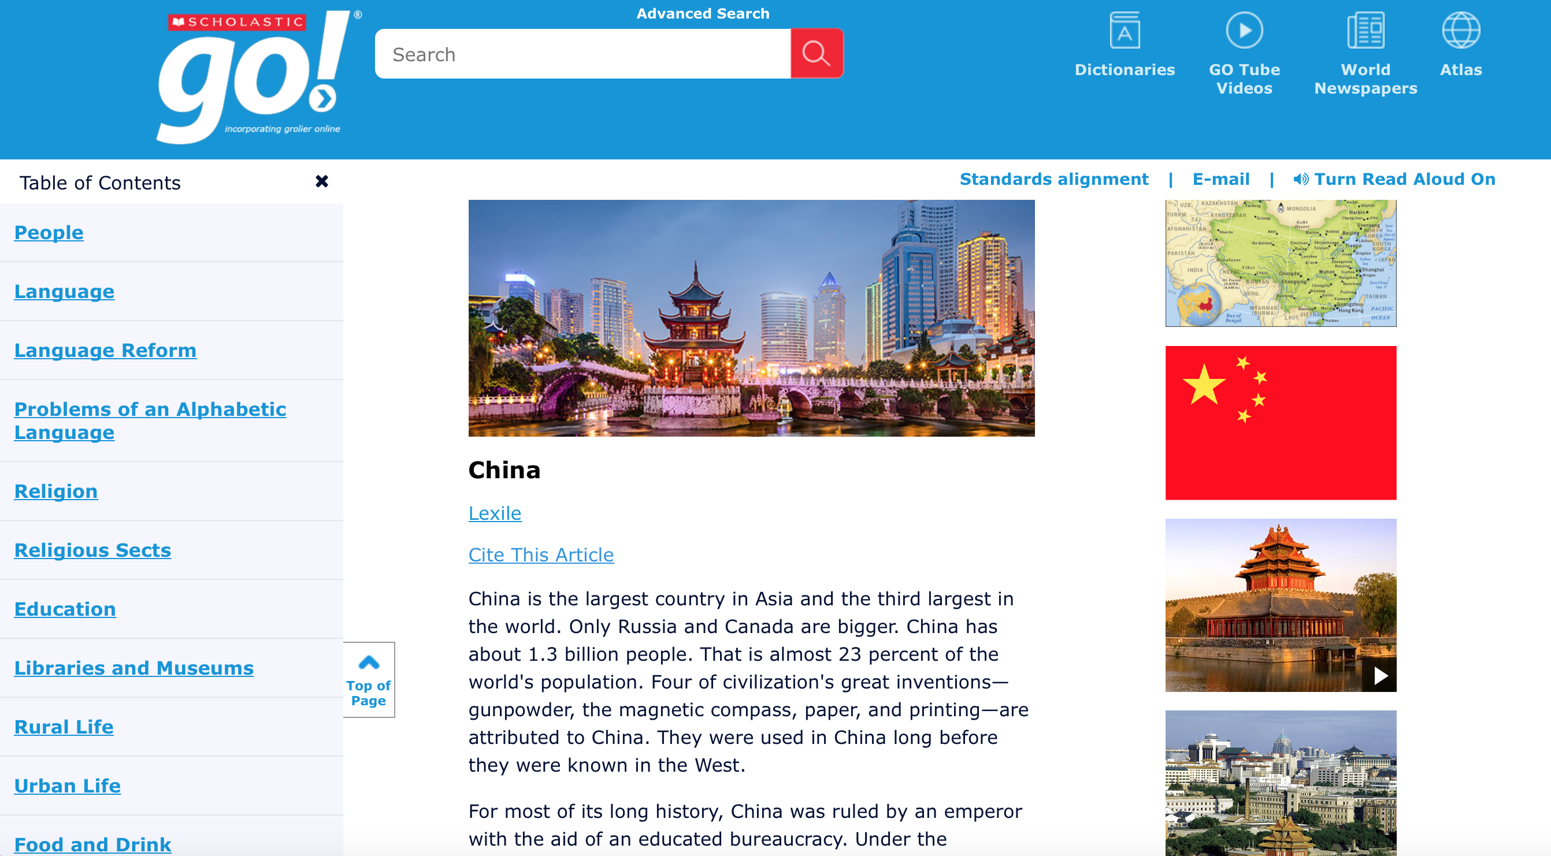
Notes:
Simply click on the expand icon to the left of the TOC to open up the hyperlinked menu.

Slide 27
Notes:
At the top right of each article are three additional tools: standard alignment, email, and read aloud.

Slide 28
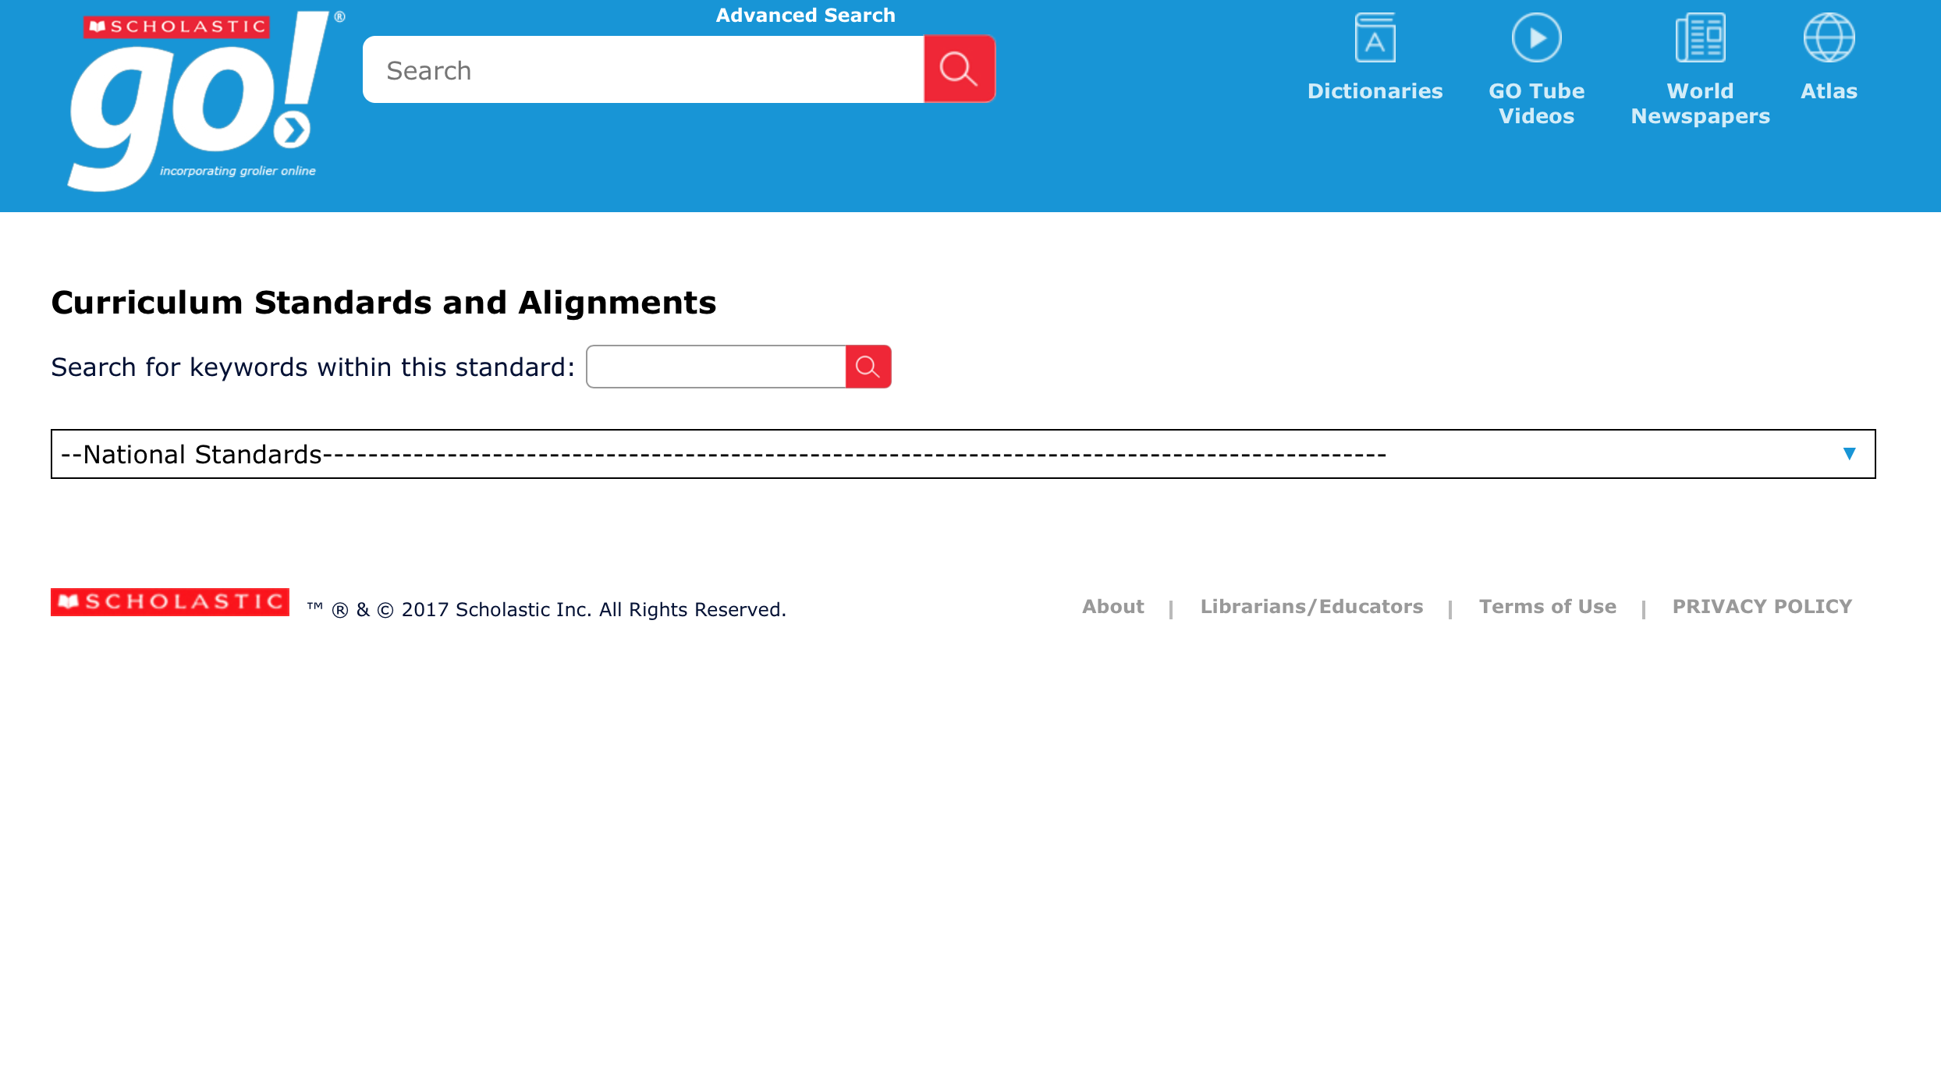
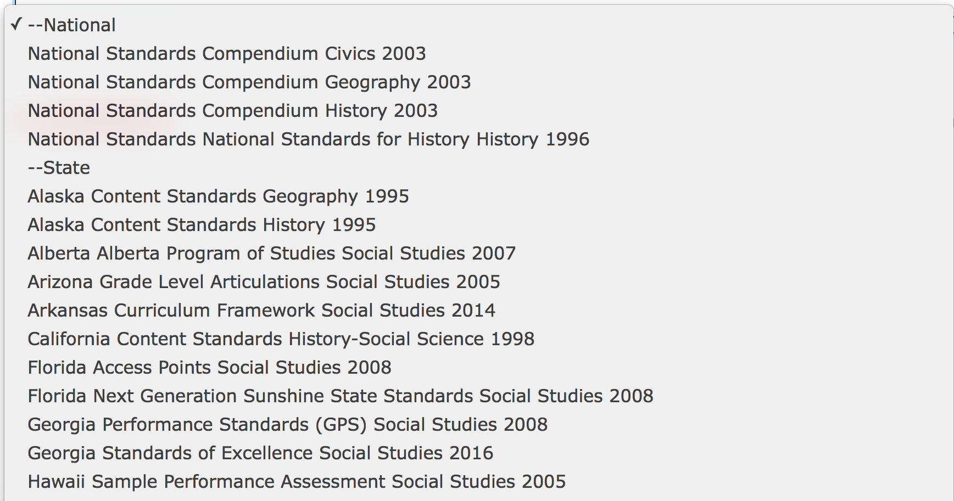
Notes:
Clicking the standard alignment link will bring you to this screen where you can select the national or state standard you’re looking to correlate to. Clicking on the drop down will prompt an alphabetical listing of first national and then state standards. These are updated as soon as new standards become available and are officially adopted by a state.

Slide 29
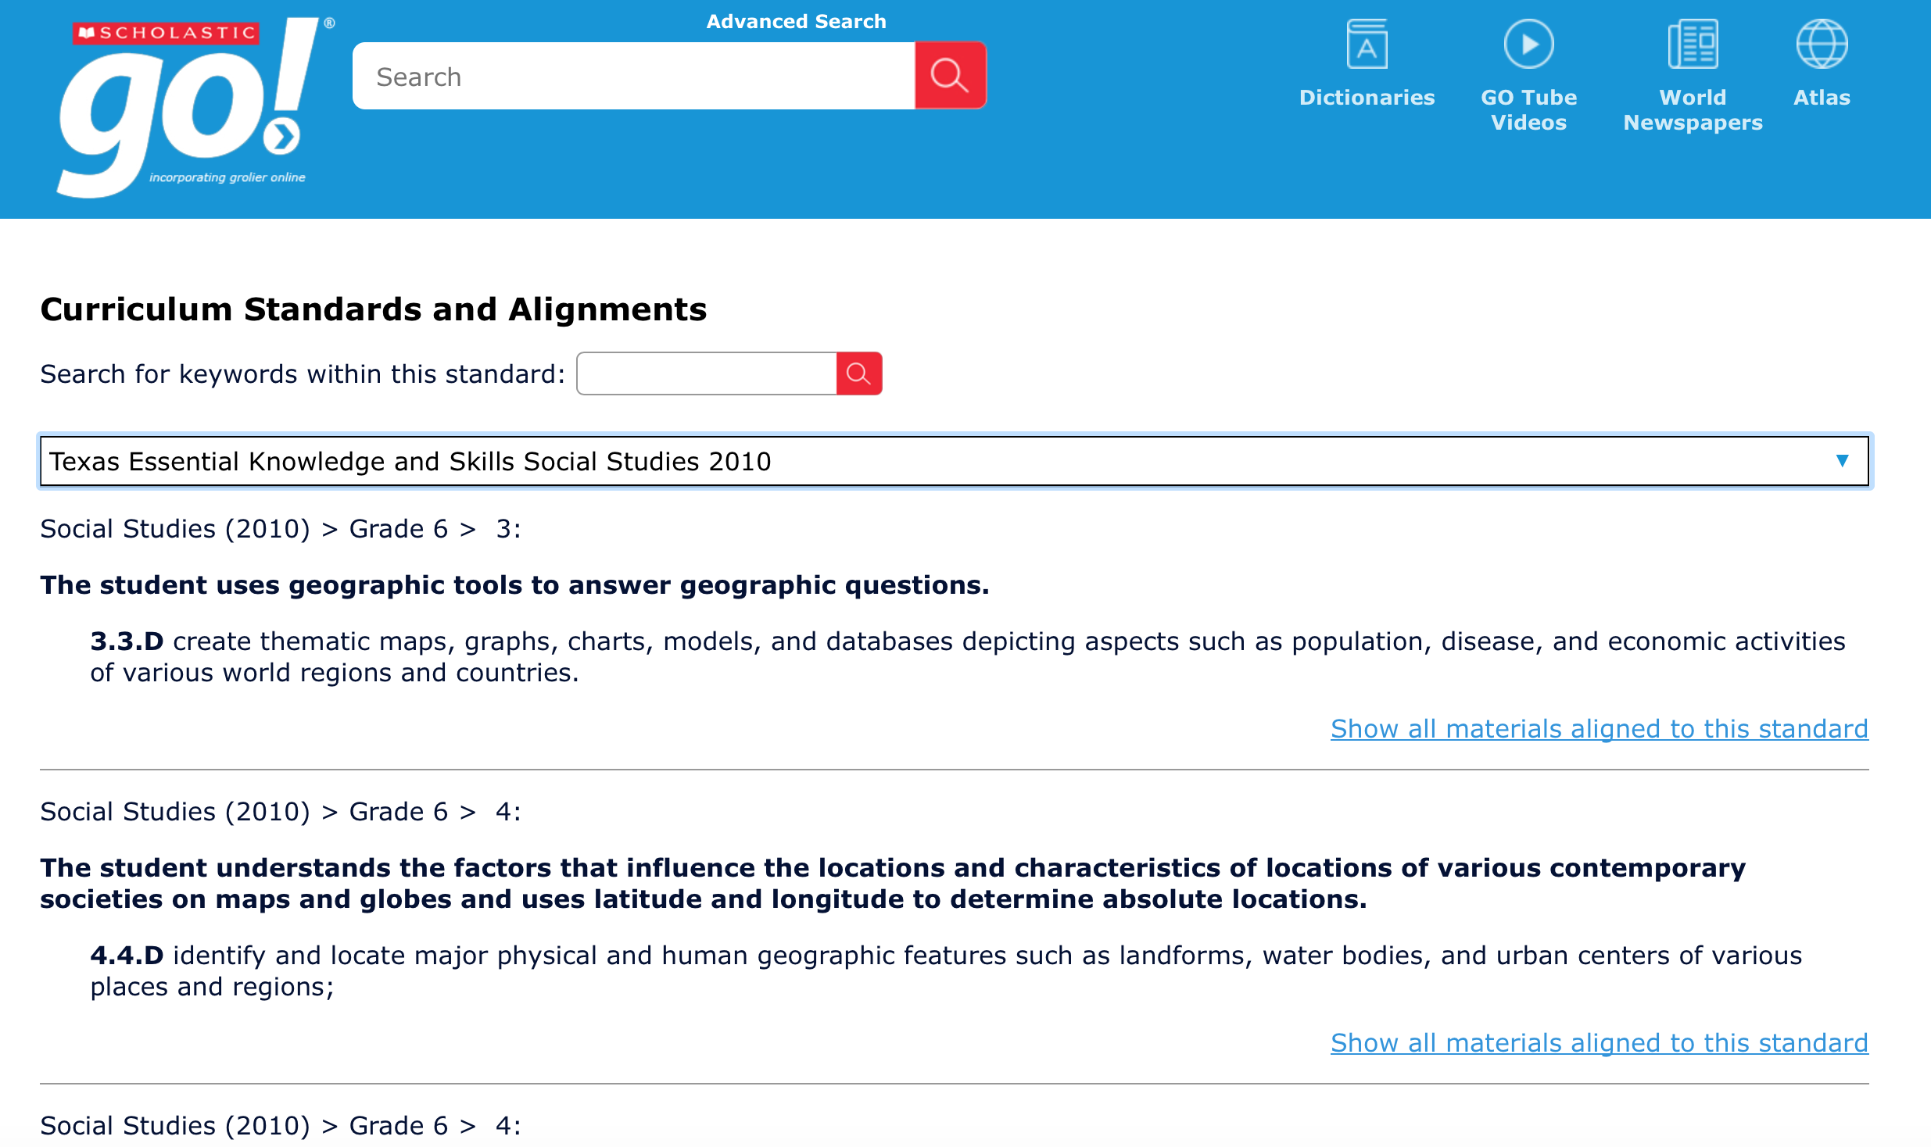
Notes:
I chose the Texas Essential Knowledge Skills standards because Texans love their standards! You’ll see here the specific standards that this particular China article correlates with. Perhaps equally useful is this link to the right which allows you to find all materials within GO that align to this standard.

Slide 30

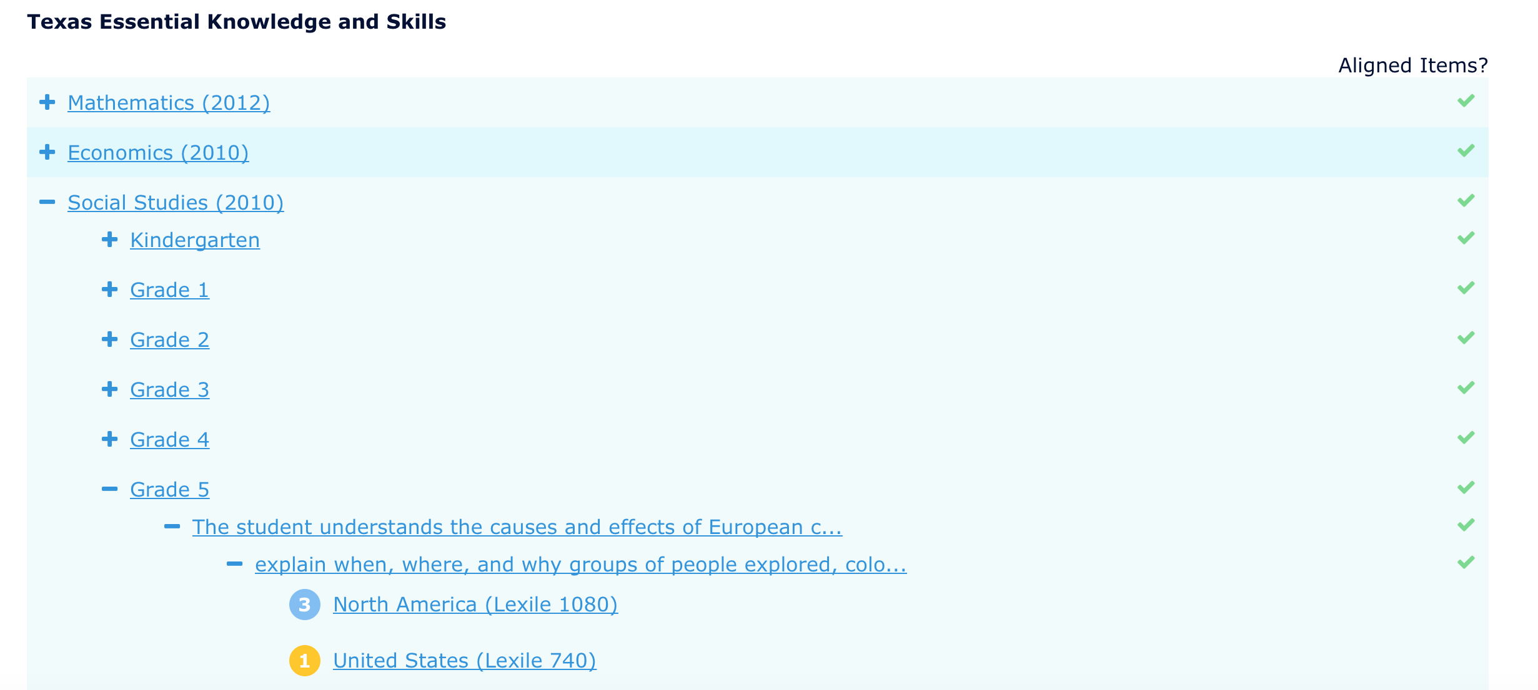
Notes:
When clicking on this link, you can further sort by subject, grade, specific standard, drilling down until you find all content that applies.

Slide 31
Notes:
A read-aloud feature can be enabled by clicking the “Turn Read Aloud On” link in the top right corner.

Slide 32
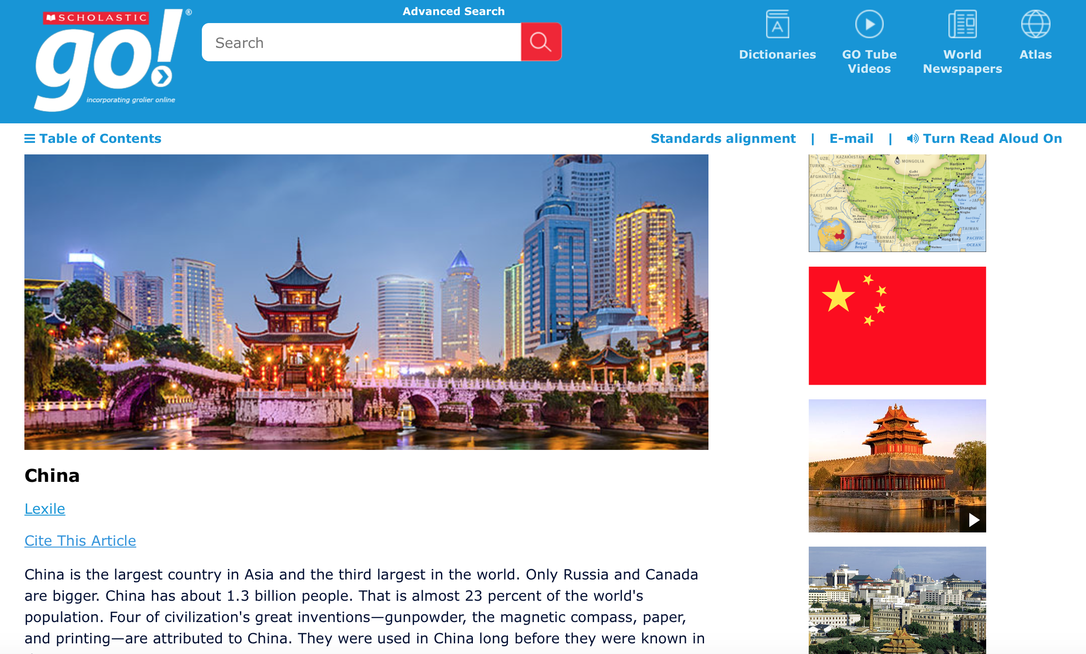
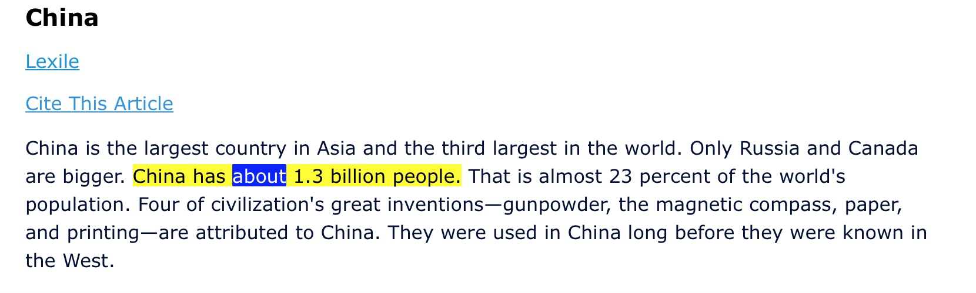
Notes:
Simply click the read aloud and select the sentence you’d like to begin with within the text. The words are highlighted as they’re read aloud to support beginning and struggling readers and well as ELL and ESL students.

Slide 33
Notes:
Any of our articles and texts can be emailed as well, which is perfect for teachers looking to push content at various levels to their students or students working collaboratively.

Slide 34
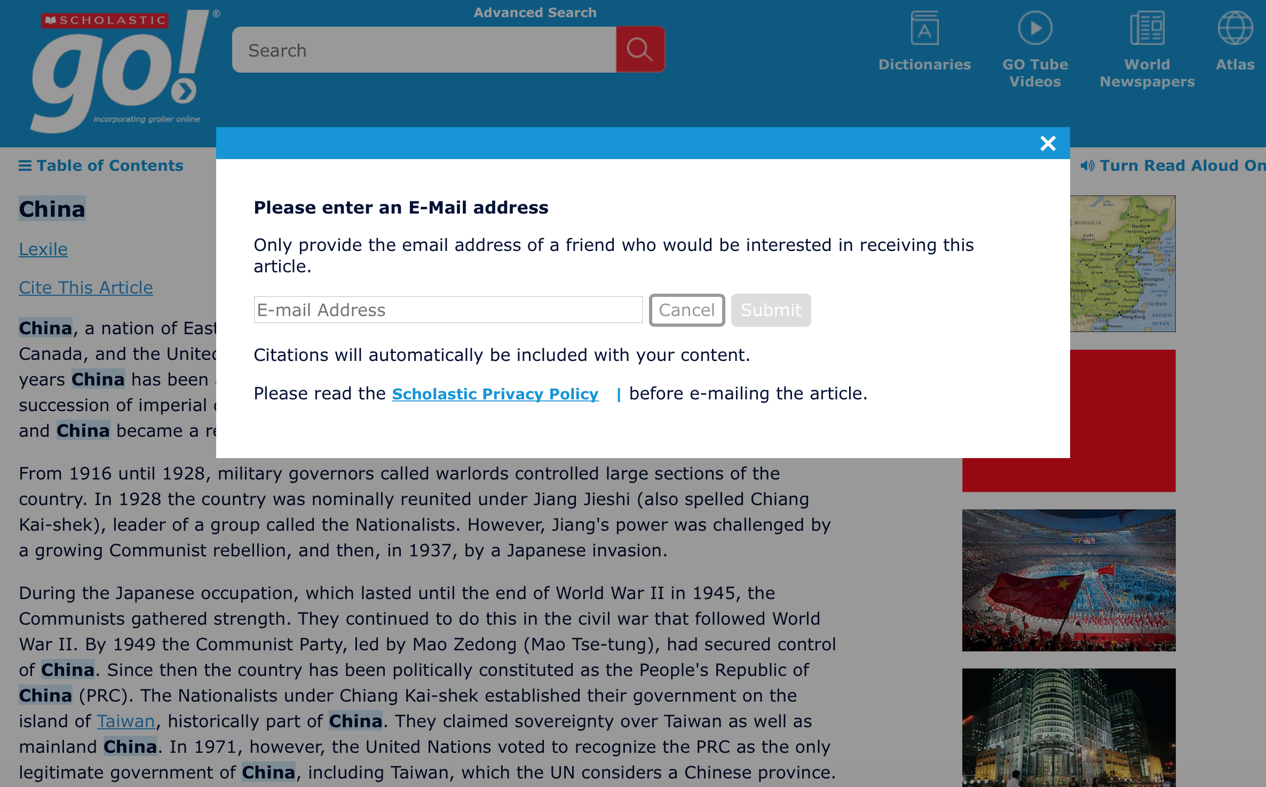
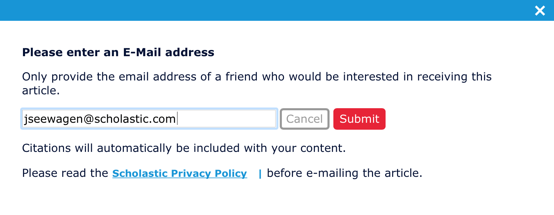
Notes:
Simply click email, fill in the email address field and hit submit. The recipient will receive an email from email-article@scholasticlibrary.com

Slide 35
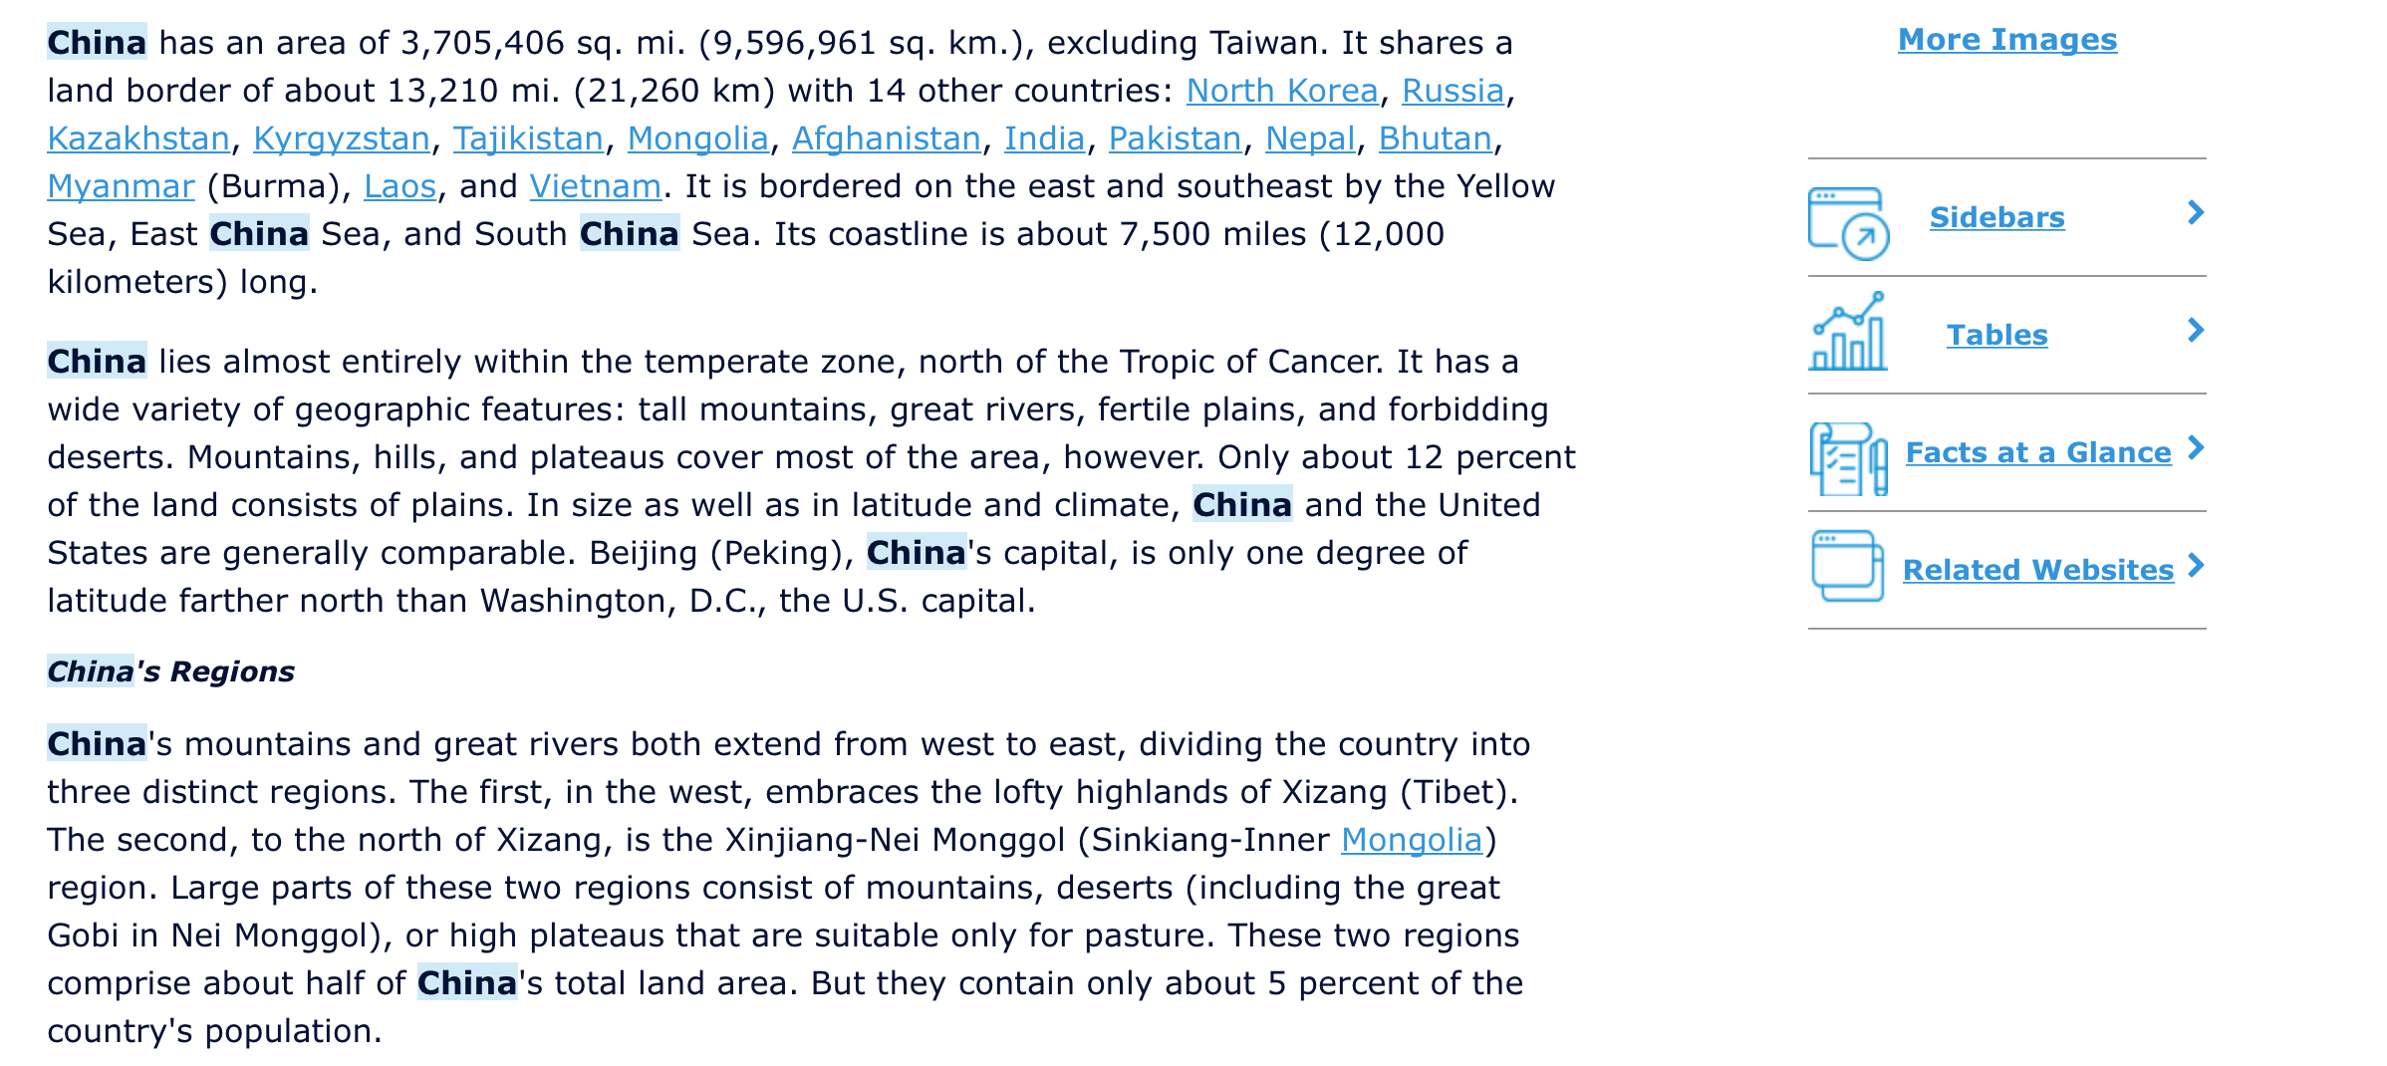
Notes:
Finally, I just want to point out that all the additional text types that apply to a certain article can be found along the right of the article, below the images. This is again designed to help users quickly find what they need and eliminating the need to always return to the search results page.

Slide 36
Where do you want to go?
Notes:
With more than 115,000 articles, 80,000 curated websites, thousands of photos, videos and additional text features, Scholastic GO can take you anywhere you want to go.

Slide 37
Thank You
scholastic.com/go
(800) 387-1437
digitalinfo@scholastic.com
Notes:
Thank you for your time and we look forward to partnering with you to help you reach all of your teaching and learning goals.

